Slide 1
DIARRHEAL DISEASES IN CHILDREN AND MANAGEMENT

Slide 2
INTRODUCTION
High morbidity and mortality
Death mainly by dehydration
Chronic diarrhoea leads to severe malnutrition and associated illnesses.

Slide 3
WORLDWIDE PICTURE
Pneumonia
8.5%
Diarrhea
5.8%
TB
3.9%
Measles
2.1%
• Infections - 24.4%
• Ischemic Heart Disease - 12.5%
Malaria
1.7%
Tetanus
1.1%
Pertussis
0.7%
HIV
0.6%
0
2
4
6
8
Percent
Lancet 1997;349:1269

Slide 4
Definition
___________________________
Symptomatic definition: Increased frequency, fluidity or volume, or a combination of these
Physiologic definition: Increased secretion or decreased absorption or usually both, causing > 200 mL liquid excretion per day

Slide 5
RISK FACTORS
Most agents transmitted through the fecal oral route and there are a few behavioral changes that encourage transmission and these include;
Failure to exclusively breastfeed for the first six months.
Using infant feeding bottles
Storing cooked food at room temperature
Using contaminated drinking water
Failing to wash hands after defeacation or a diaper change
Unhygienic disposal of feaces

Slide 6
Host factors
Failure to be breastfeed until 6/12.
Malnutrition
Other co morbidities e.g measles
Immunodeficiency states

Slide 7
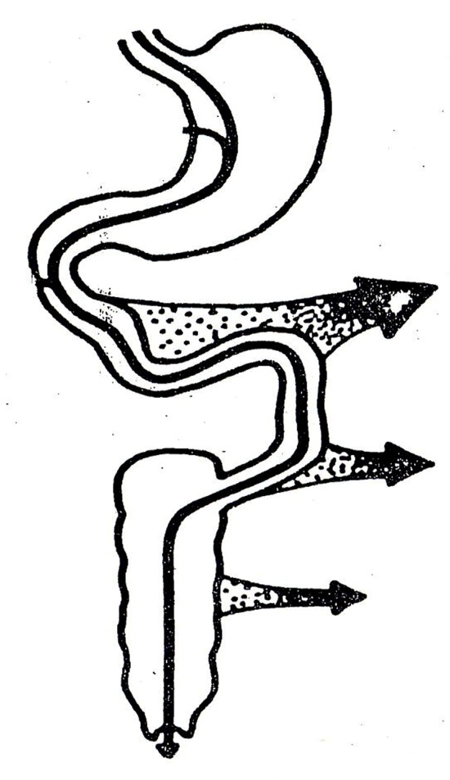
Input
Absoption
Diet/Saliva : 3 L/d
Stomach : 2 L
Jejunum : 5 L/d
Bile : 1 L
Pancreas : 2 L
Bowel : 1 L
Ileum : 2-3 L
Colon : 1-2 L
Total 9 L
Total 8.8 L
Fecal Water 100-200 mL/d
Thus, diarrhea is defined as >200 mL liquid excretion per day.

Slide 8
AETIOLOGY
Viruses- Rotavirus which accounts for 15-25% of all the causes.
Bacteria- Enterotoxigenic Escherichia coli, Shigella, campylobacter jejuni, vibrio cholera01, salmonella.
Protozoa; cryptosporidium, amoebiasis
There are times when no pathogen is isolated which is about 20-30% of the time.

Slide 9
Clinical Classification
Acute vs Chronic
Infectious vs Non-infectious
Osmotic vs Secretory
Inflammatory vs Non-inflammatory
Large intestine vs Small intestine
Drugs

Slide 10
ACUTE VS CHRONIC
ACUTE; Diarrhoea that resolves within two weeks.
CHRONIC; Recurrent or long lasting diarrhea, lasting >4 weeks, usually due to non infectious causes e.g sensitivity to gluten or inherited metabolic disorders.
The most useful classification clinically

Slide 11
2) Infectious vs Non-infectious
Infectious - Blood, pus, epidemic, travel
Less likely infectious - Afebrile, non-bloody, non-mucoid, sporadic, no travel

Slide 12
3) Osmotic vs Secretory
Osmotic- Diarrhea ceases with fasting as the absorbable solute is not present.
Secretory- Diarrhea continues with fasting as there is active secretion of water into the lumen.

Slide 13
4) Inflammatory vs Non-inflammatory
Inflammatory - Blood, pus, fever, abdominal pain, tenesmus, fecal leukocytes
Non-inflammatory - Watery stool, without blood/pus/fever/fecal leukocytes

Slide 14
5) Large vs Small Intestine
Large intestine - Frequent urges, mushy/ dark colored/rarely foul smelling, left lower quadrant pain, tenesmus, small volume
Small intestine - Watery/light colored/foul smelling, periumbilical/RLQ pain, large volume

Slide 15
Pathogenetic Mechanisms(for infectious diarrhea)
VIRUSES
Replicate within villous epithelium of the small bowel -patchy epithelial cell destruction and villous shortening.
Loss of the normally absorptive villous cells and their temporary replacement by immature secretory crypt like cells causes the intestine to secrete water and electrolytes
Villous damage also be associated with loss of disaccharides especially lactose.
Recovery occurs when villi regenerate and villous epithelium matures.
Role of zinc!!

Slide 16
Approach to the patient
Resuscitate- REFER TO PAEDS PROTOCOL!!
Hx
Exam
Rehydrate-PAEDS PROTOCOL
Acute Vs Chronic- investigations and management differ

Slide 17
ORAL REHYDRATION THERAPY
Based on fact that intestinal absorption of sodium is enhanced by certain food molecules example glucose.
This process functions normally during secretory diarrhoea.
A balanced isotonic solution of glucose causes glucose linked sodium reabsortion to occur and this is accompanied by absorption of water and other electrolytes.

Slide 18
INTRAVENOUS THERAPY
For patients with severe dehydration or shock.
All fluids available have some electrolyte deficits and ORS should be given together as soon as patient is able to take orally.

Slide 19
RINGERS LACTATE
Best preferred solution
Has adequate concentration of sodium and sufficient lactate which is metabolzed to bicarbonate for acid base correction.
However low in potassium and glucose and does not correct hypoglycaemia.
Has NA-130, K-4, Cl-109,lactate-28

Slide 20
Other Acceptable fluids
NORMAL SALINE
Does not contain a base to correct acidosis and it does not replace potassium losses.
HALF STRENGTH DARROWS
Contains less sodium chloride than is needed to efficiently correct the sodium deficit in patients with severe dehydration.

Slide 21
HALF NORMAL SALINE
Comes with 50g or 100g glucose per litre but does not correct acidosis nor does it replace potassium losses
UNACCEPTABLE SOLUTION;
PLAIN GLUCOSE-WHY?????

